Slide 1



TO OUR ENGLISH CLASS

Slide 2
Unscramble words
rkpa
diusatm
llma
ymg
sorte
atr agllrye
ropsts rencet
=> park
=> stadium
=> mall
=> gym
=> store
=> art gallery
=> sports center

Slide 3

Theme 1: FREE TIME
Lesson 3

Slide 4

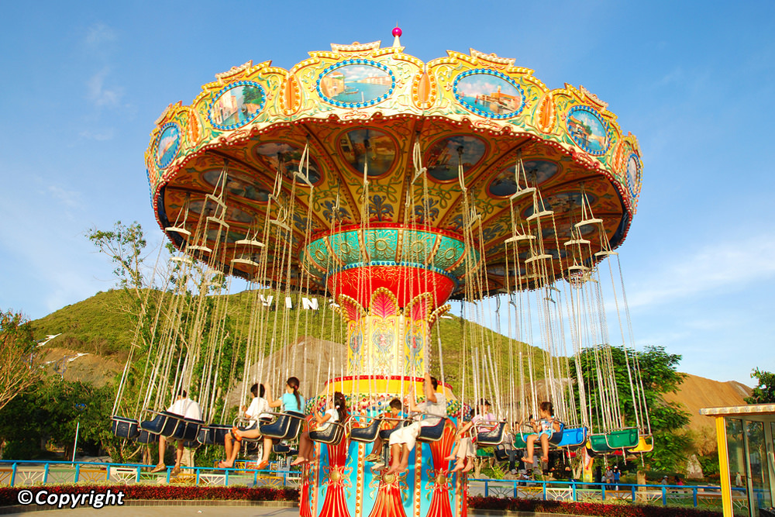
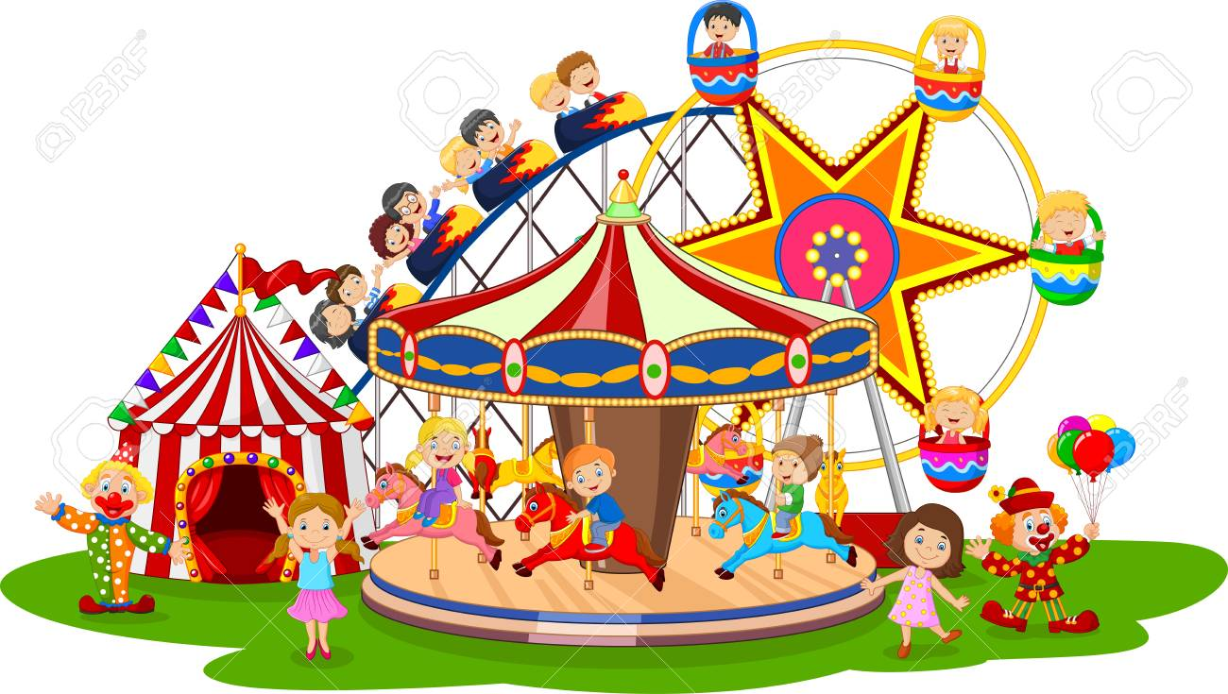


/əˈmjuːzmənt pɑːrk/
1. amusement park (n)

Slide 5
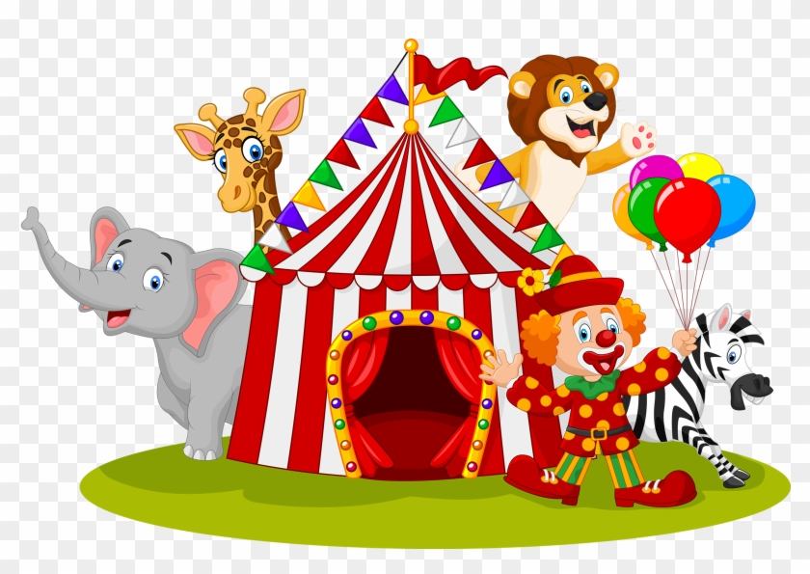
/ˈsɜːrkəs/
2. circus (n)
Notes:
roup of people, sometimes with trained animals, who perform acts with skill in a show that travels around to different places

Slide 6
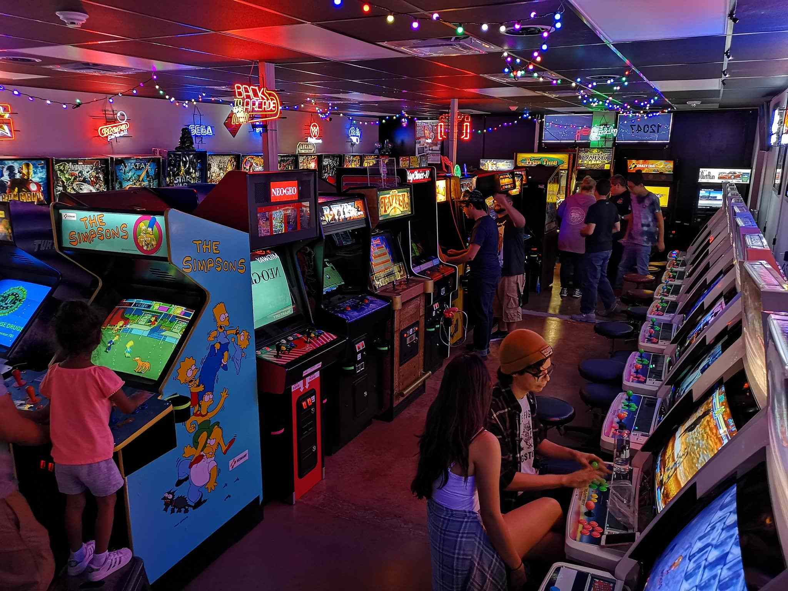
/ɑːrˈkeɪd/
3. arcade (v)
Notes:
amusement arcade)
a place where you can play games on machines which you use coins to operate

Slide 7
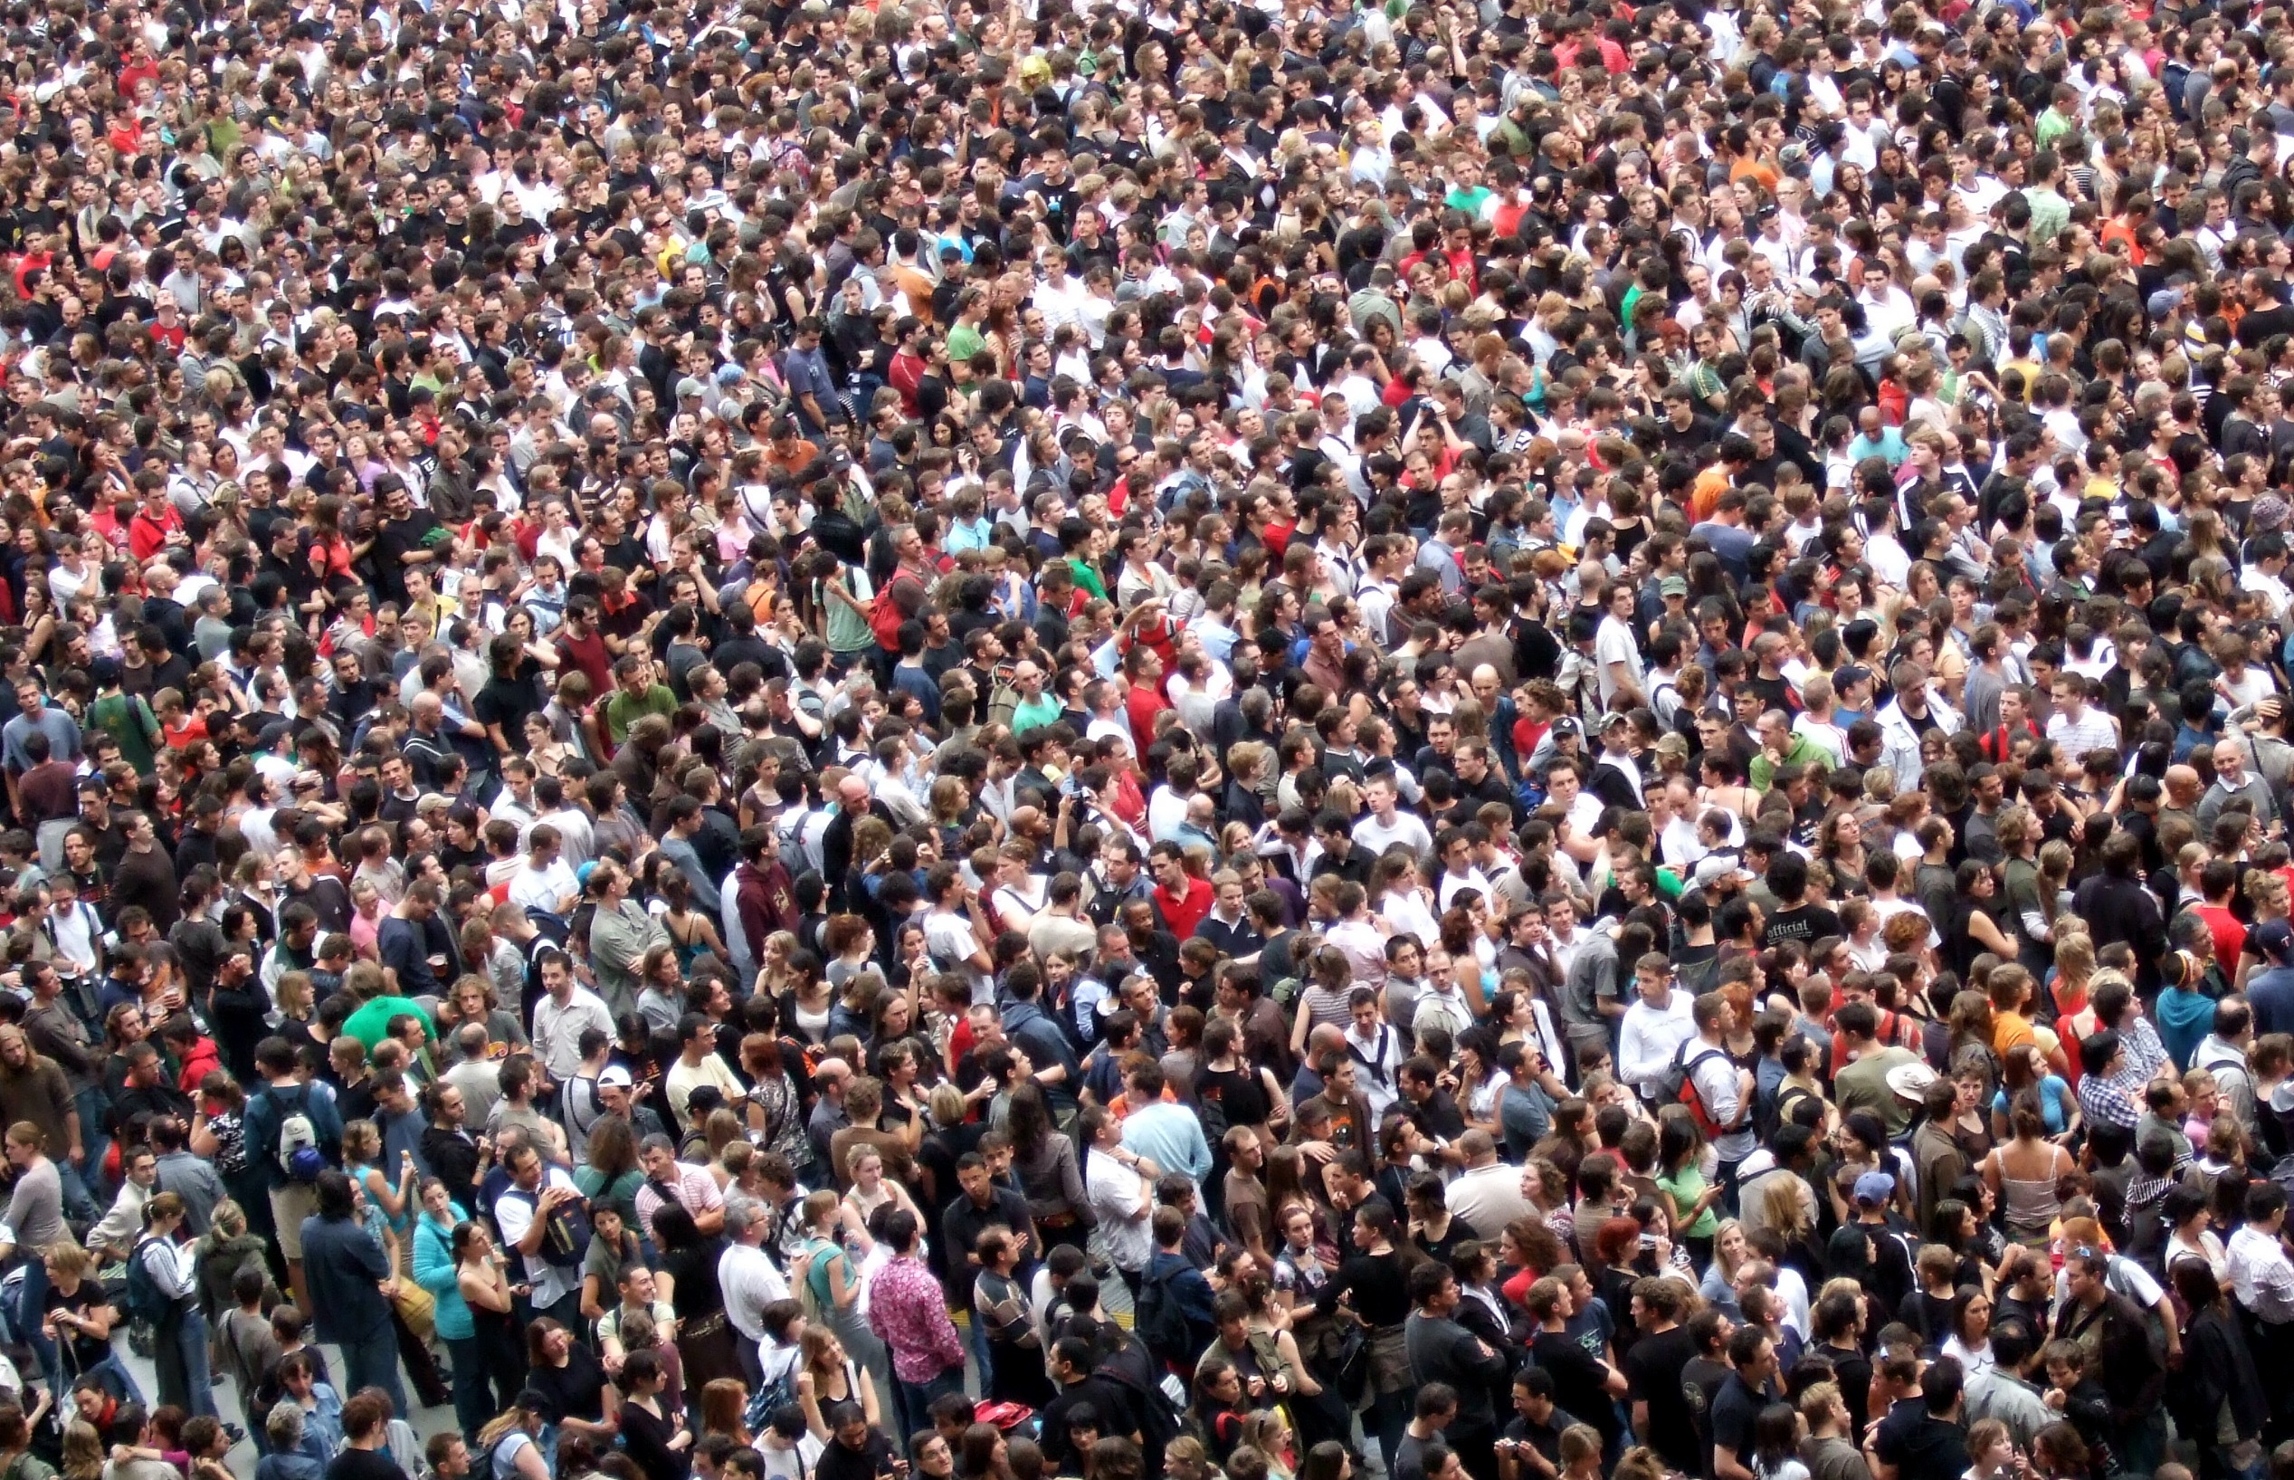
4. crowded (adj)
/ˈkraʊdɪd/
Notes:
having a lot of people or too many people

Slide 8
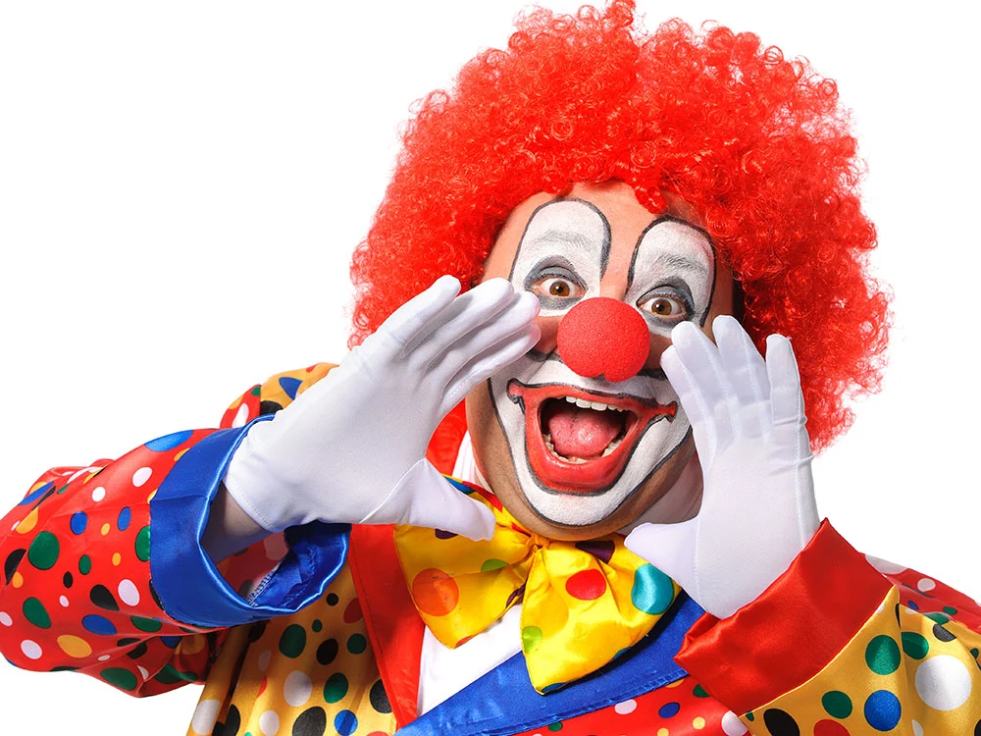
/klaʊn/
5. clown (n)

Slide 9
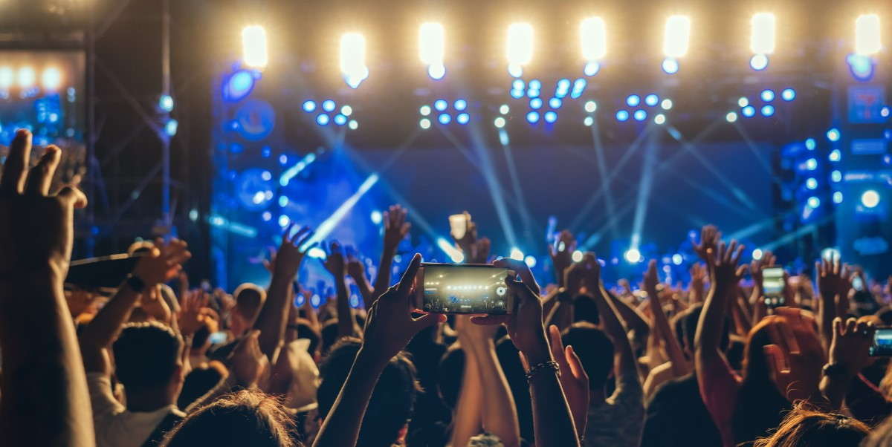
6. concert (n)
/ˈkɒnsət/

Slide 10
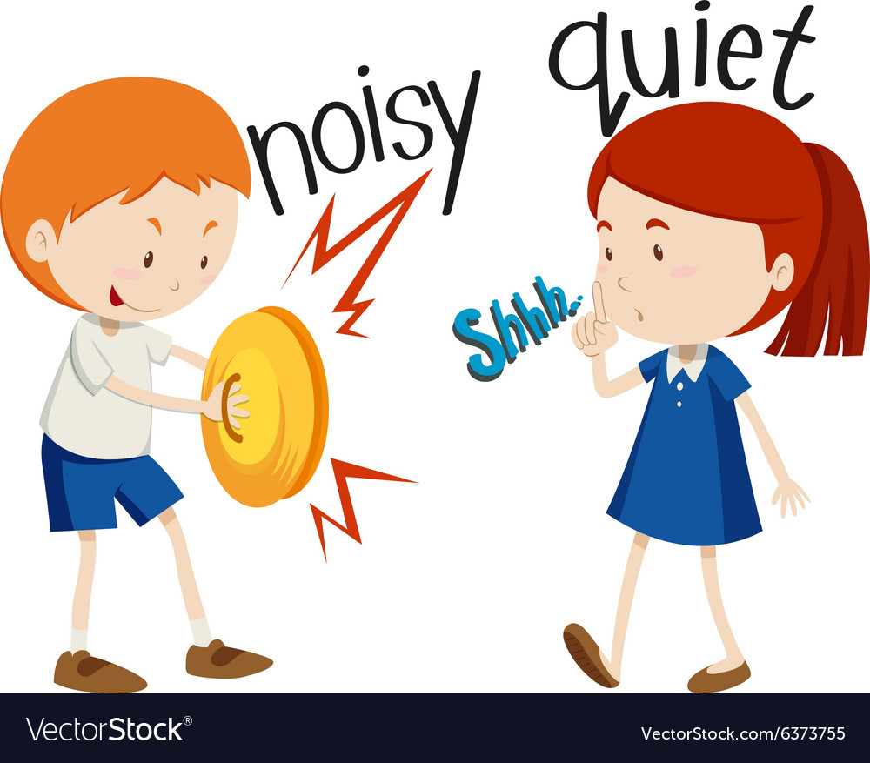
/ˈnɔɪzi/
7. noisy # quite (adj)

Slide 11
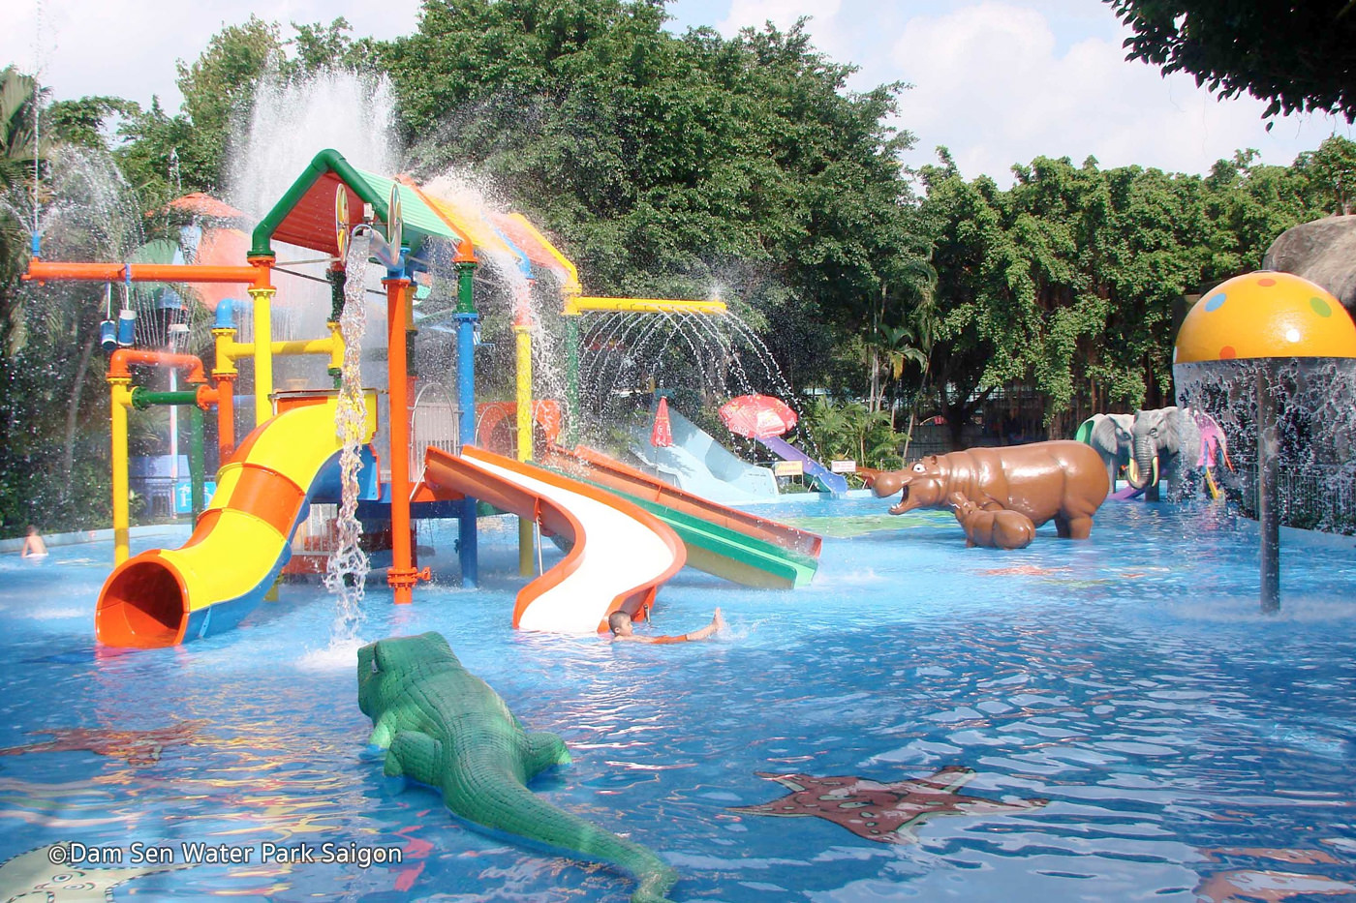
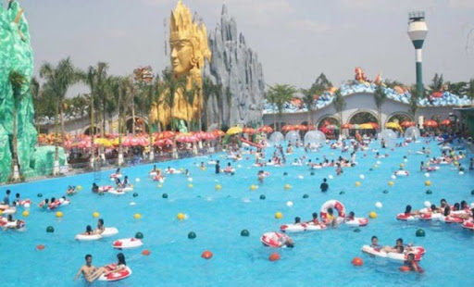
8. water park (n)

Slide 12
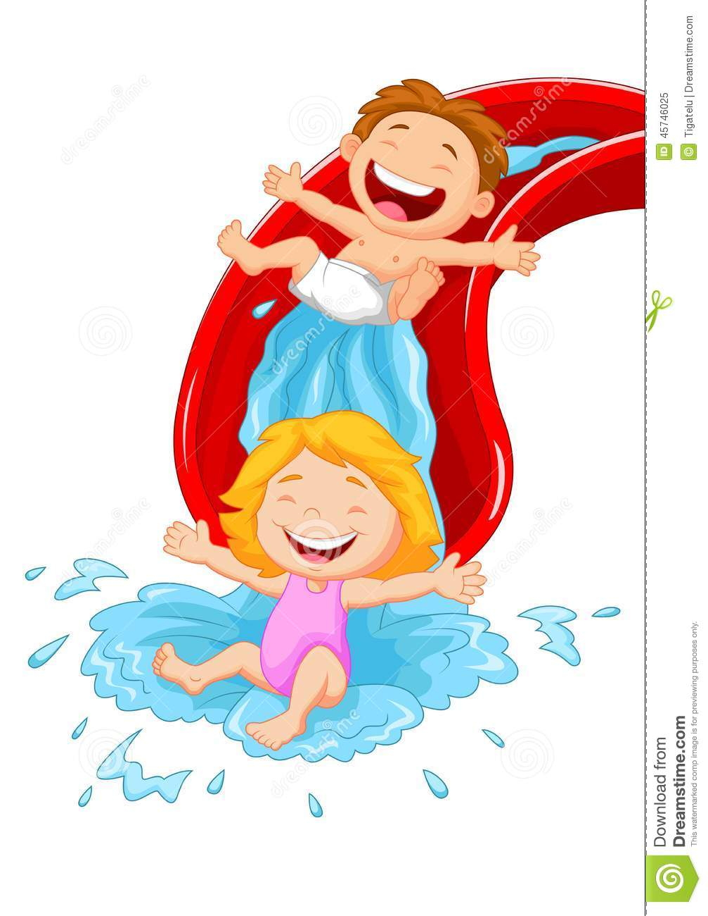
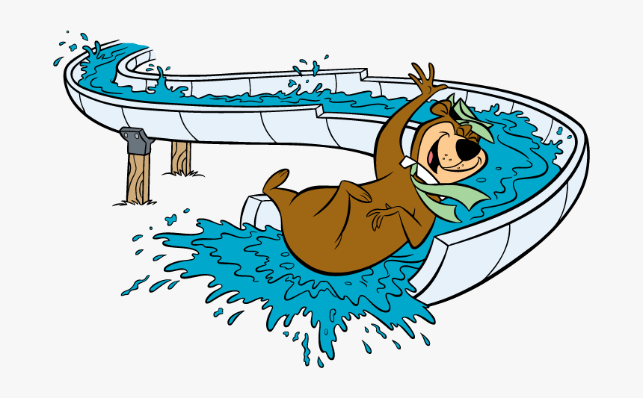
9. water slide (n)

Slide 13
New words:
amusement park (n)
circus (n)
arcade (n)
Crowded (adj)
Clown (n)
Concert (n)
Noisy # quiet (adj)
Water park (n)
Water slide (n)
: công viên giải trí
: rạp xiếc
: khu trò chơi điện tử
: đông đúc
: chú hề
: buổi hòa nhạc
: ồn ào # yên tĩnh
: công viên nước
: cầu trượt nước

Slide 14

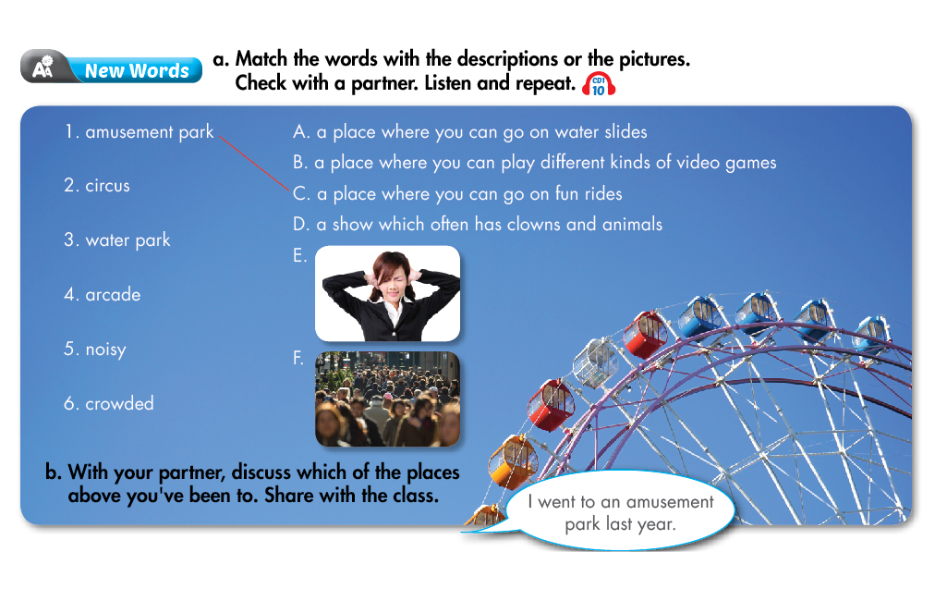
i-Learn Smart World 7 – Theme 1
Exercise 1:
Page
8
Notes:
Step 1: teach the new vocabularies
Step 2: listen and match
Step 3: discuss in pairs

Slide 15

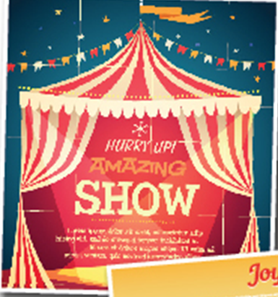
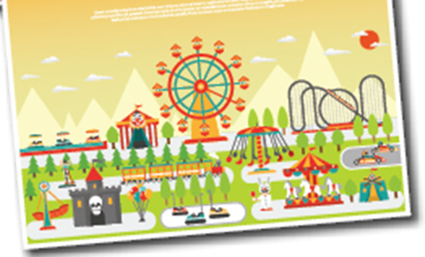
LISTENING
Exercise 2:Listen and write “Yes” or “No”.
Two friends are making plans for a day out.
a. Max wants to go to the circus.
b. Ken thinks the circus will be boring.
a. Ken want to go to the arcade.
b. They decided to go to the movies.
Yes
No
No
Yes
1.b.Ken thinks the circus will be fun.
2.a.Ken doesn’t want to go to the arcade.
Page
8
Notes:
Step 1: first time just listen
Step 2: second time choose the correct word
Step 3: check the answers

Slide 16
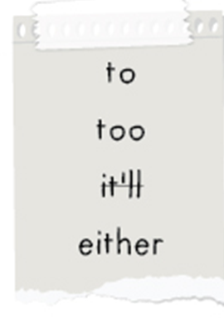
Exercise 3: Fill in the blanks.
The speaker say:
a. I want to go to the circus. I think _____be really fun.
b. I do _____.
a. We could _____ go to the arcade or the movies.
b. I don’t want to go _____ the arcade.
it’ll
too
either
to

Slide 17


A: We could either go to the concert or to the movies.
B: I want to go to the concert.
A: I don’t want to go to the concert. I think it’ll be noisy.
B: I do too. Let’s go to the movies.
Useful Language
want + to V1 = would like + to V1
(muốn làm cái gì)
Ex: a. I want to go to the circus.
b. I would like to go to the movies.
either… or ...
(hoặc … hoặc …)
Ex. a. We could either go to the circus or the concert.
b. We could either go to the arcade or the movies.
Ex:
A: I like ice cream
B: I do too.
So do I
“too” and “so”
(cũng vậy)
S+ do/ does + too
So + do/ does + S

Slide 18
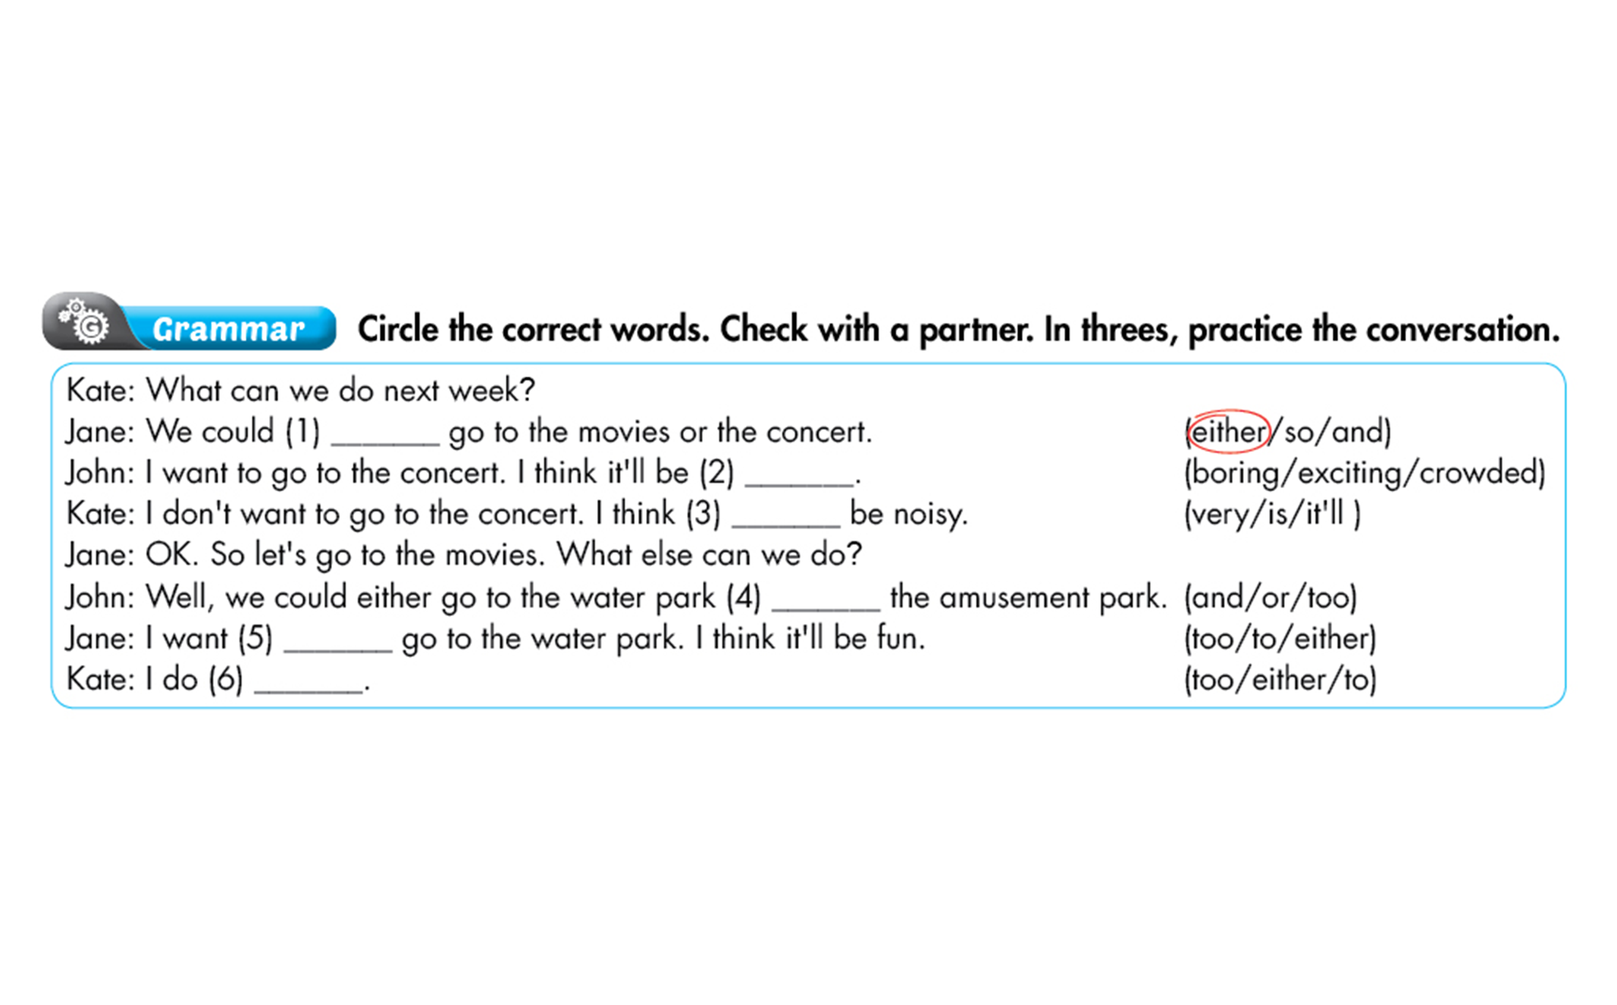
Exercise 4: Circle the correct words.

Slide 19
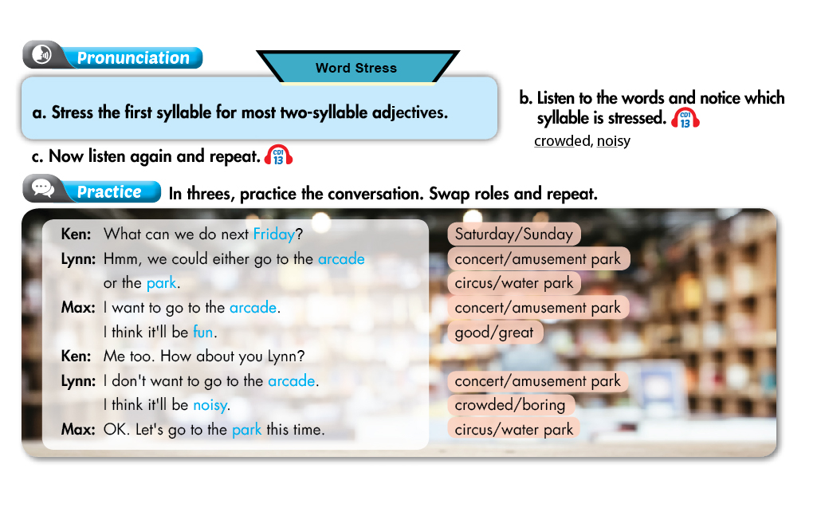
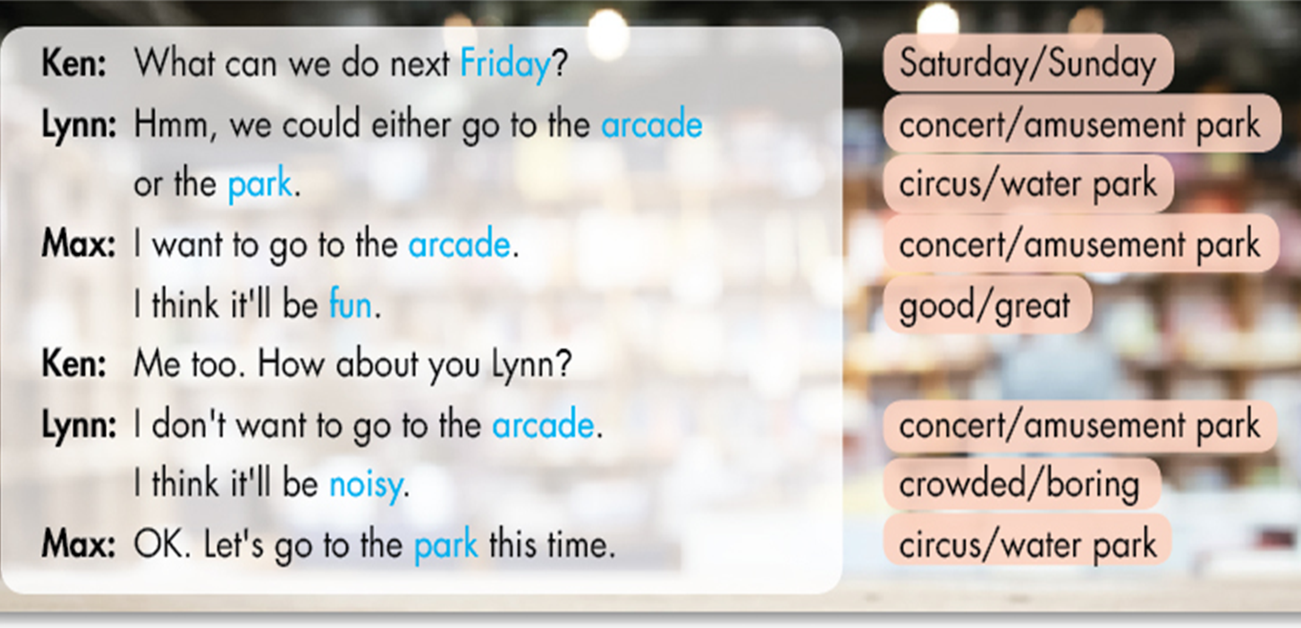
i-Learn Smart World 7 – Theme 1
Page
9
Notes:
Step 1: teach new words
Step 2: get the students to repeat

Slide 20
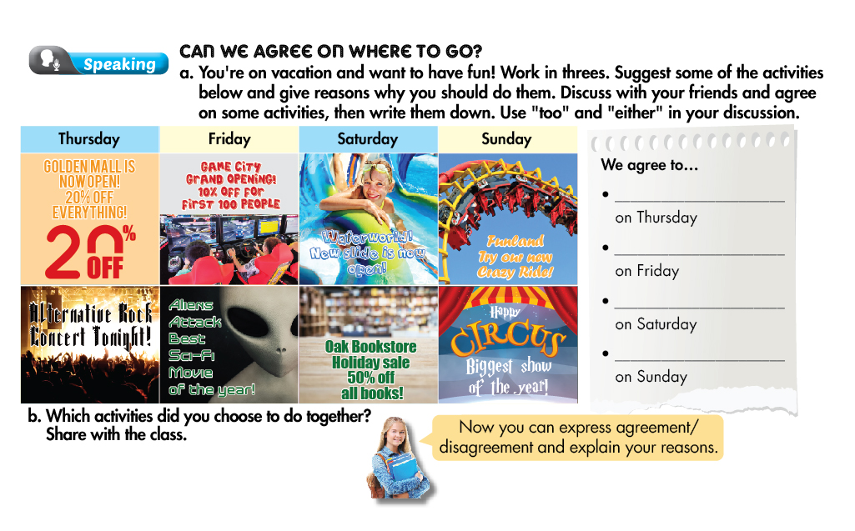
i-Learn Smart World 7 – Theme 1
Page
9
Notes:
Step 1: teach the activities
Step 2: discuss in groups
Step 3: make the timetable

Slide 21

Exercise 5: Combine these sentences with “either…or…” to offer a choice between two things.
Ex: We could go to the amusement park. We could go to the arcade.
⇨ We could
either go to the amusement park or the arcade.
1. We could go to the circus. We could go to the water park.
⇨ We could
either go to the circus or the park.
2. We could go to the bookstore. We could go to the movies.
⇨ We could
either go to the bookstore or the movies.
3. We could go to the park. We could go to the zoo.
⇨ We could
either go to the park or the zoo.
4. We could go to the mall. We could go to the supermarket.
⇨ We could
either go to the mall or the supermarket.

Slide 22

Exercise 6: Underline the mistakes in the sentences. Then write the correct words.
=> on
What can we do at Sunday?
We could either go camping and go fishing.
I don’t want going fishing.
I do either. I think it’ll be boring.
I’d want to have lunch at Spring Restaurant. It’s next to the water park.
6. I did too.
=> or
=> to go
=> too
=> like
=> do

Slide 23
Homework
Learn new words and grammar of the today lesson.
Finish the exercises in WB.
Prepare for the next lesson.

